Slide 1

FINAL PROJECT:
Brazilian E-Commerce Public Dataset by Olist
Presenter: Nguyen Huy Toan

Slide 2
Table of contents
01
About the dataset
02
Business Overview
03
Customer
04
Delivery Performance
05
Reviews

Slide 3
Period
05/09/2016 18/10/2018
About the data
Quarter 3, 2016 to Quarter 4, 2018
This is a Brazilian ecommerce public dataset of orders made at Olist Store
Activity
Olist connects small businesses from all over Brazil to channels
Those merchants are able to sell their products through the Olist Store and ship them directly to the customers using Olist logistics partners

Slide 4
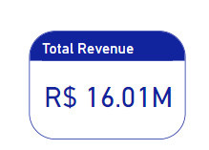
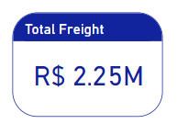
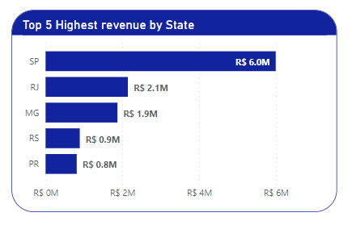
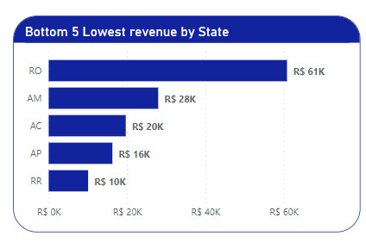
2. Business Overview
Revenue by State
Best performance: São Paulo – SP
(~ 37.5 % of Total Revenue)
Worst performance: Roraima– RR
(~ 0.06 % of Total Revenue)

Slide 5
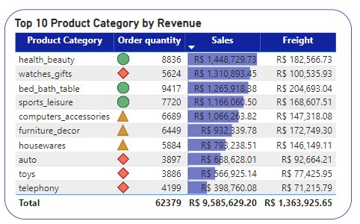
2. Business Overview
Revenue by Product Category
Products with the largest revenue:
health_beauty
(~ 9.05 % total order value )
(~ 8.88 % total number of products sold – top 2)
Notes:
.

Slide 6
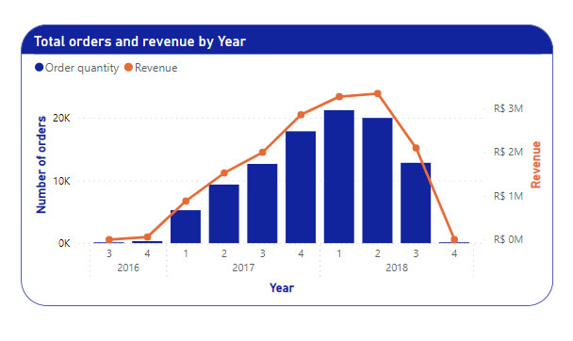
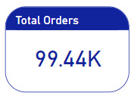
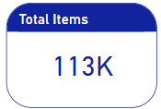
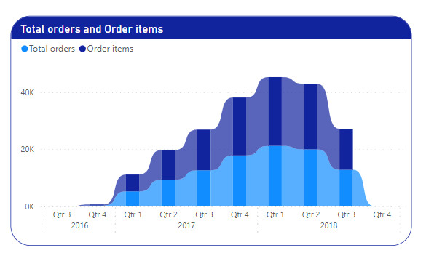
2. Business Overview
Sales over the years
Total orders and revenue
Trend:
Quarter 3, 2016 to Quarter 1, 2018
Quarter 2, 2018 to Quarter 4, 2018

Slide 7
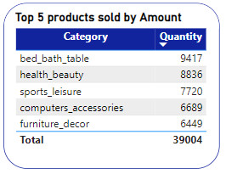
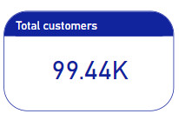
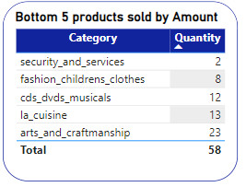
3. Customer
Most popular products
Best performance: bed_bath_table
(~ 9.5 % total number of products sold)
(Top 5 ~ 39.2 % total number of products sold)
Worst performance: security_and_services

Slide 8
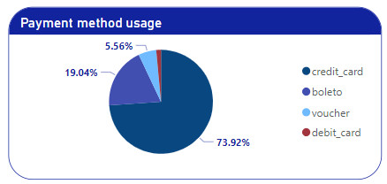
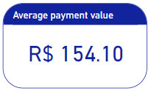
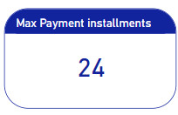
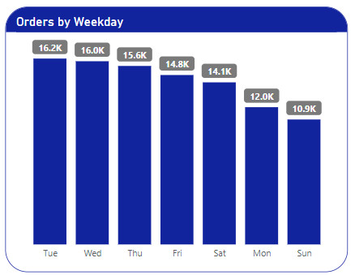
3. Customer
Customer buying habits
Most popular payment method:
credit_card
What day of the week do customers preferto buy?
Tuesday

Slide 9
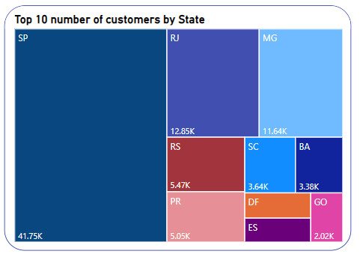
3. Customer
Where are Olist's customers the most?
Largest number of customers:
São Paulo – SP
(~ 42 % total number customers)
(Top 5 ~ 39.2 % total number of products sold)

Slide 10
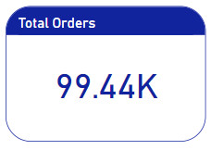
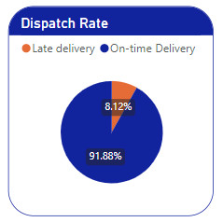
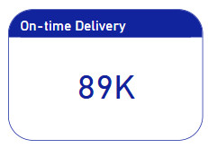
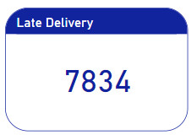
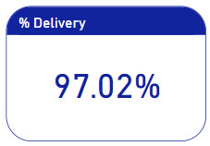
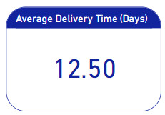
4. Delivery Performance
KPIs

Slide 11
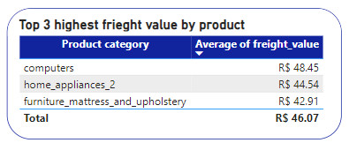
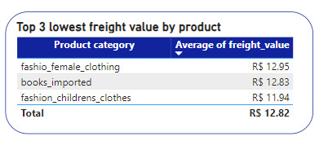
4. Delivery Performance
Freight value
The highest freight value:
Computers
The lowest freight value:
Fashion_childrens_clothes

Slide 12
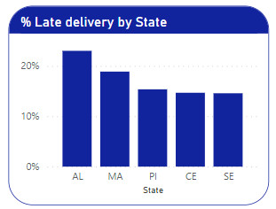
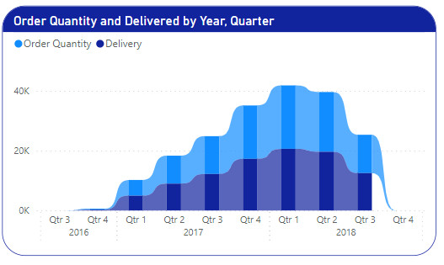
4. Delivery Performance
The state has the slowest shipping rate
Alagoas – AL
(~23% total number of late delivery)
The difference between Order Quantity & Delivered
Quarter 1, 2018: 581
Notes:
.

Slide 13
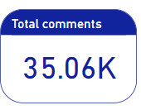
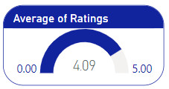
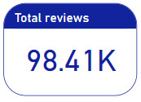
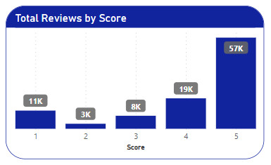
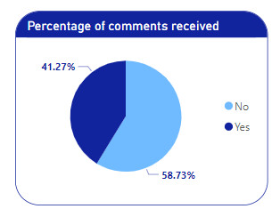
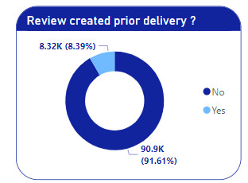
5. Reviews
Overview
Ratings:
number of dissatisfied customers ( 1-2)
(~ 14% total number of reviews)
number of extremely satisfied customers (5)
(~58% total number of reviews)

Slide 14
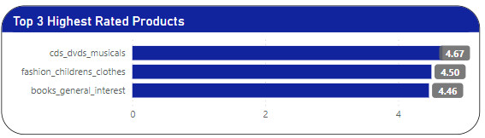
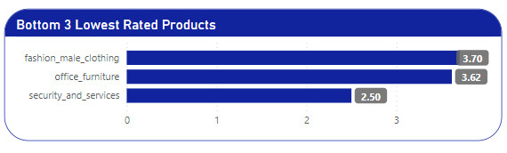
5. Reviews
What is the highest rated product ?
Most popular products:
Cds_dvds_musicals
The product has the lowest rating
Security_and_services

Slide 15
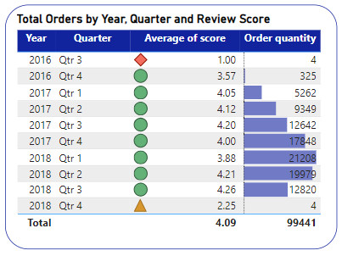
5. Reviews
Quarter 4, 2016 – Quarter 3,2018

